Slide 1
Natural Language Processing, Deep Nets, Linear Algebra and Information Retrieval
Kenneth Church
Northeastern University
k.church@northeastern.edu
Wednesday, June 21
https://github.com/kwchurch/JSALT_Better_Together

Slide 2
Exercises (Lab for for this afternoon) https://github.com/kwchurch/JSALT_Better_Together/tree/main/doc/exercises
Simple usage of
Semantic Scholar’s API
Input: paper ids
Outputs: titles, abstracts, more ids, references, citations, embeddings
Models on HuggingFace
Input: titles + abstracts
Output: vectors (embeddings)
Dimension Reduction (Singular Value Decomposition (SVD))
Reduce BERT vectors from 768 dimensions to 2 dimensions (for plotting)
Replicate the centroid assumption
Centroid Assumption: vector of a doc is close to centroid of its references

Slide 3
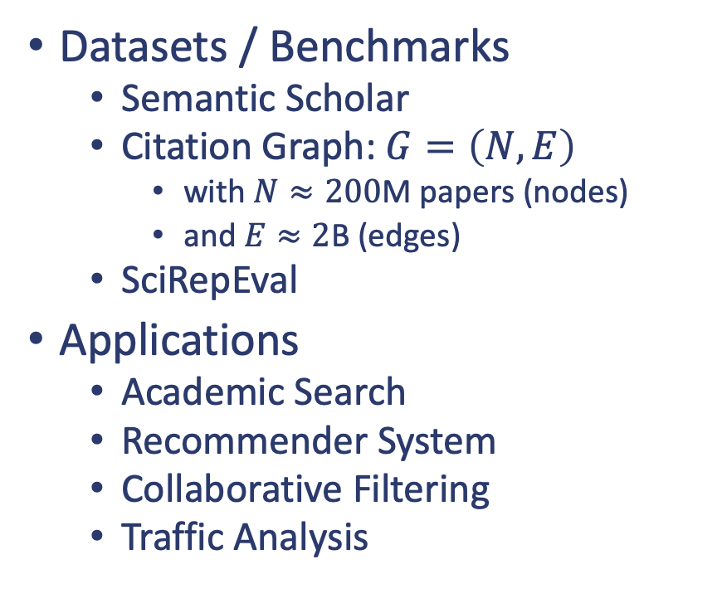
Introduction
Research Areas
Natural Language Processing (NLP)
Deep Nets (BERT)
Inference, Fine-tuning, Pretraining
Linear Algebra
Singular Value Decomposition (SVD)
Spectral Clustering
Information Retrieval (IR)
Datasets / Benchmarks
Semantic Scholar
Citation Graph: $G=\left(N, E\right)$
with $N≈200$M papers (nodes)
and $E≈2$B (edges)
SciRepEval
Applications
Academic Search
Recommender System
Collaborative Filtering
Traffic Analysis

Slide 4
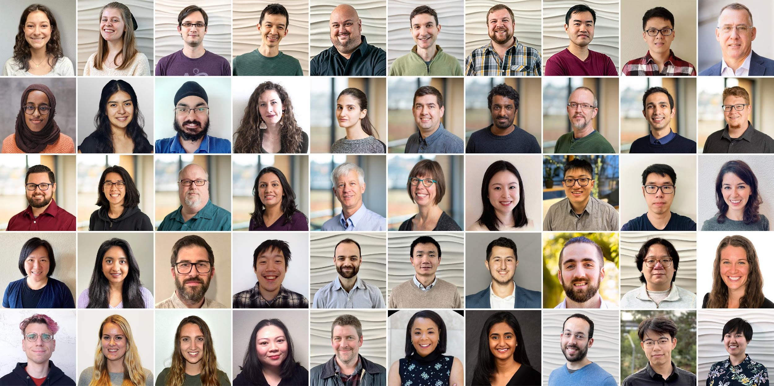
Semantic Scholar: Significant Effort (slide from Dan Weld)
50 person team
7 year project
207M+ scientific paper index
8M+ monthly active users

Slide 5
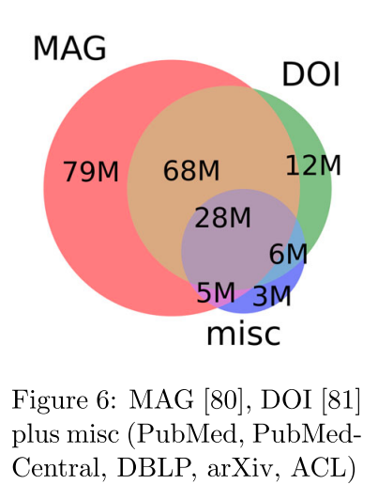
Semantic Scholar
Seven Sources
Fields of Study
Medicine (45M) | Engineering (8M) | Business (4M) | Geology (3M)
Chemistry (13M) | Physics (7M) | Sociology (3M) | History (2M)
Computer Science (13M) | Psychology (7M) | Geography (3M) | Art (2M)
Biology (13M) | Mathematics (5M) | Economics (3M) | Philosophy (1M)
Materials Science (10M) | Political Science (4M) | Environmental Science (3M)

Slide 6



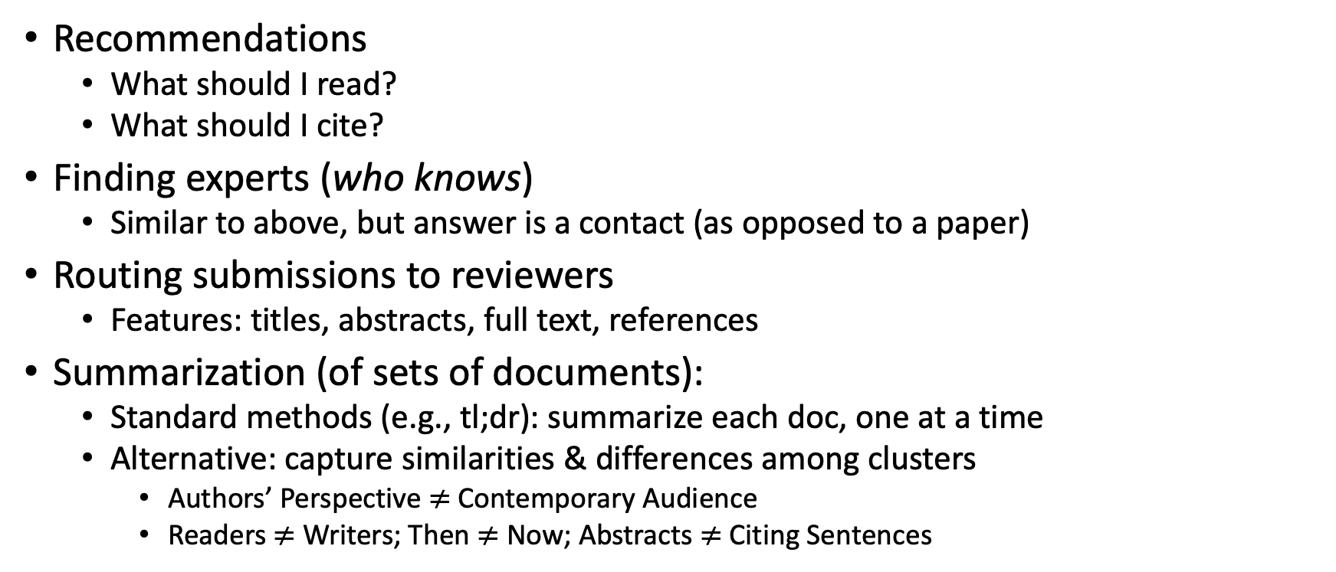
Document Similarities: Use Cases
Recommendations
What should I read?
What should I cite?
Finding experts (who knows)
Similar to above, but answer is a contact (as opposed to a paper)
Routing submissions to reviewers
Features: titles, abstracts, full text, references
Summarization (of sets of documents):
Standard methods (e.g., tl;dr): summarize each doc, one at a time
Alternative: capture similarities & differences among clusters
Authors’ Perspective $≠$Contemporary Audience
Readers $≠$ Writers; Then $≠$ Now; Abstracts $≠$ Citing Sentences

Slide 7

Better Together: Text (Titles, Abstracts, Body); Context (Citations)

Slide 8
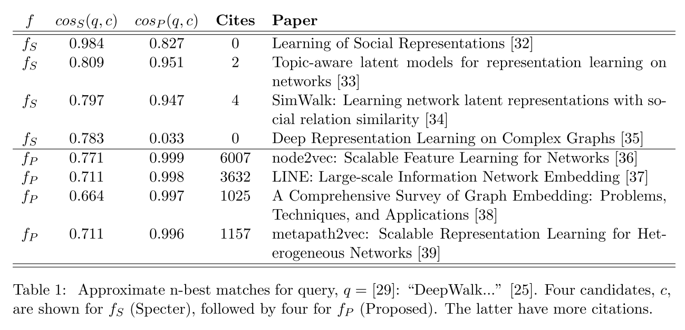
Query: ``DeepWalk: Online Learning of…’’

Slide 9
Document Similarities: Use Cases
Recommendations
What should I read?
What should I cite?
Many systems focus on ``relevance’’ (word overlap)
But we also want credibility
Don’t recommend papers that are buzz-word compliant
But not worth reading
(Most papers are never cited)

Slide 10
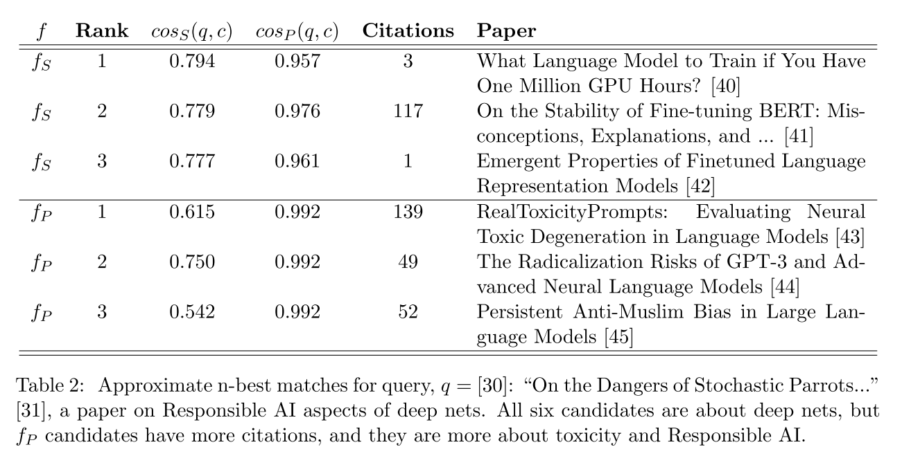
Query: ``On the Dangers of Stochastic Parrots…’’

Slide 11
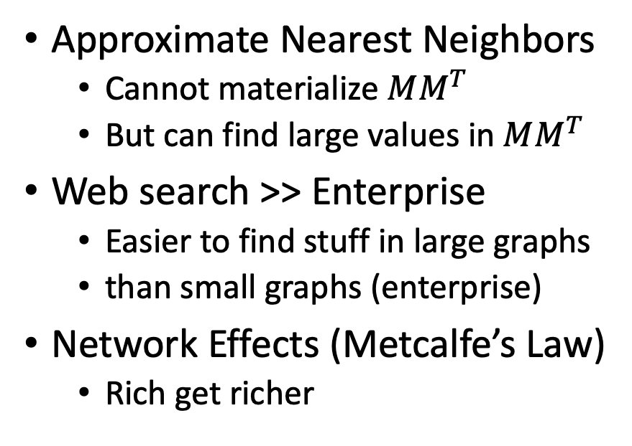
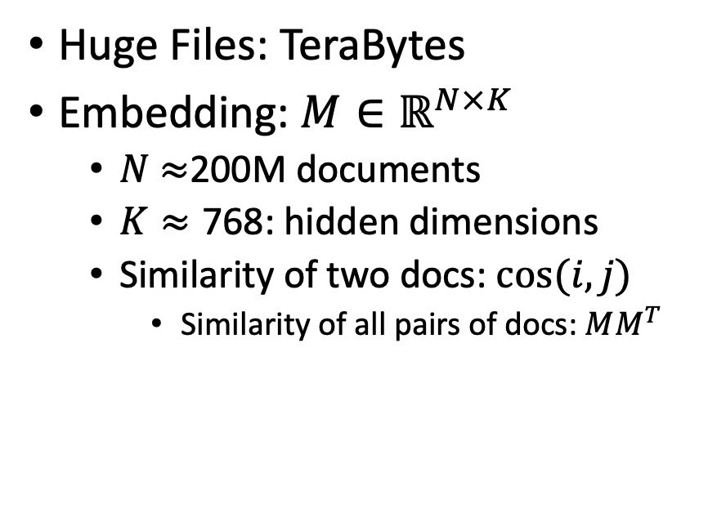
Scale
Curse
Blessing
Huge Files: TeraBytes
Embedding: $M∈ℝ^{N×K}$
$N$ $≈$200M documents
$K≈\text{768}$: hidden dimensions
Similarity of two docs: $cos(i,j)⁡$
Similarity of all pairs of docs: $MM^{T}$
Approximate Nearest Neighbors
Cannot materialize $MM^{T}$
But can find large values in $MM^{T}$
Web search >> Enterprise
Easier to find stuff in large graphs
than small graphs (enterprise)
Network Effects (Metcalfe’s Law)
Rich get richer

Slide 12

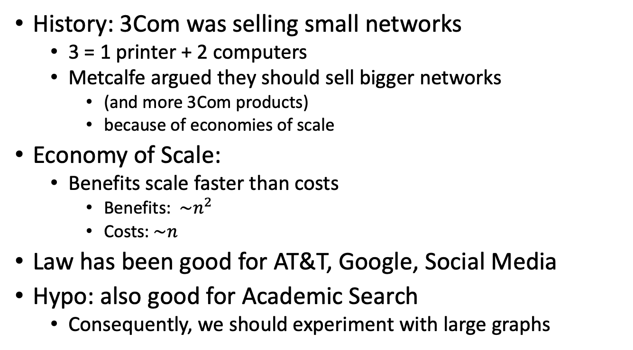
Metcalfe’s Law (Network Effects)
History: 3Com was selling small networks
3 = 1 printer + 2 computers
Metcalfe argued they should sell bigger networks
(and more 3Com products)
because of economies of scale
Economy of Scale:
Benefits scale faster than costs
Benefits: $\sim n^{2}$
Costs:$\sim n$
Law has been good for AT&T, Google, Social Media
Hypo: also good for Academic Search
Consequently, we should experiment with large graphs

Slide 13
Realities
The Real World
Idealizations (Evaluation Benchmarks)
Large (Metcalfe’s Law)
Growing
Dirty
Missing Values
Bad/misleading Values
Small
Static
Clean

Slide 14
Global Scientific Output Doubles Every 9 Years
Web companies keep indexes up to date (web is a moving target)
Ditto for Academic Search

Slide 15
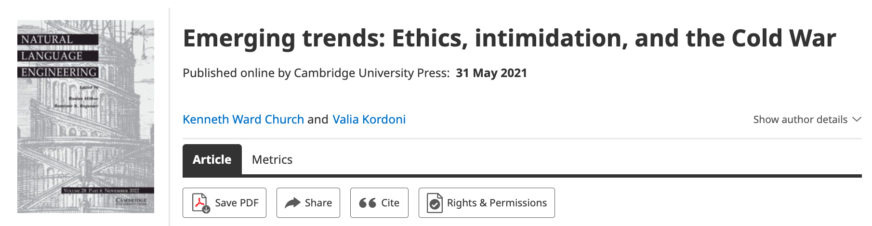
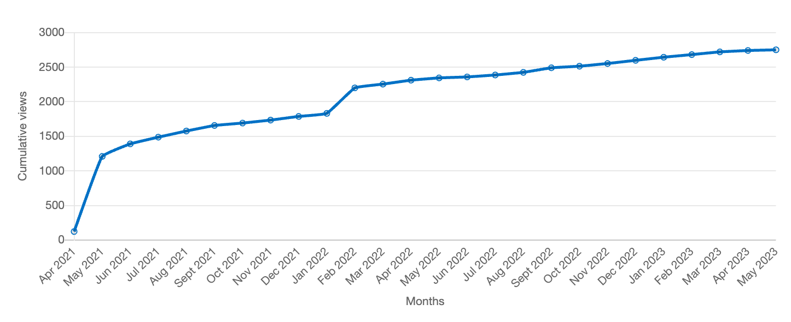
Author Contributions + Audience Appreciation (Literature is a conversation, like social media)
Author Contributions
Time Invariant
Does not change after publication
Audience Appreciation
Evolves over time
Behavioral Signals
Views
Citations

Slide 16
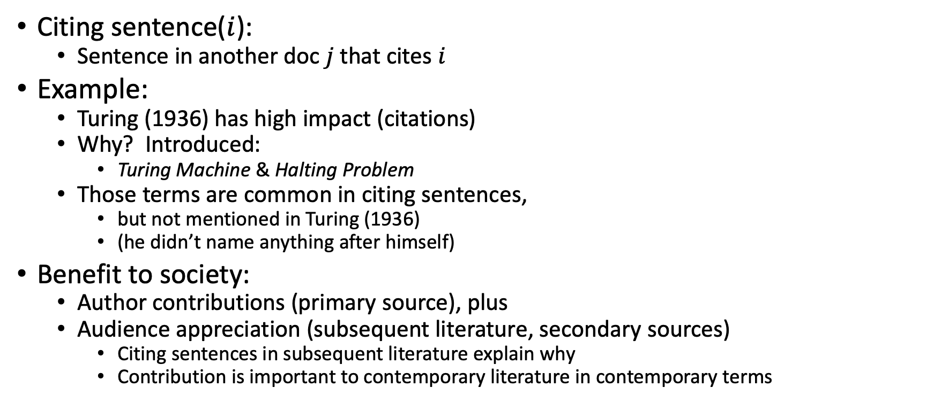
Citing Sentences
Citing sentence($i$):
Sentence in another doc $j$that cites $i$
Example:
Turing (1936) has high impact (citations)
Why? Introduced:
Turing Machine & Halting Problem
Those terms are common in citing sentences,
but not mentioned in Turing (1936)
(he didn’t name anything after himself)
Benefit to society:
Author contributions (primary source), plus
Audience appreciation (subsequent literature, secondary sources)
Citing sentences in subsequent literature explain why
Contribution is important to contemporary literature in contemporary terms
Anchor Text in Web Search

Slide 17
Why are some papers cited more than others?
Example: Word2Vec
Word2vec is not
the first, last or best
to discuss
vector spaces, embeddings, analogies, similarity metrics, etc.
But word2vec is simple and accessible.
Anyone can download the code and use it in their next paper.
Any many do (for better and for worse).

Slide 18
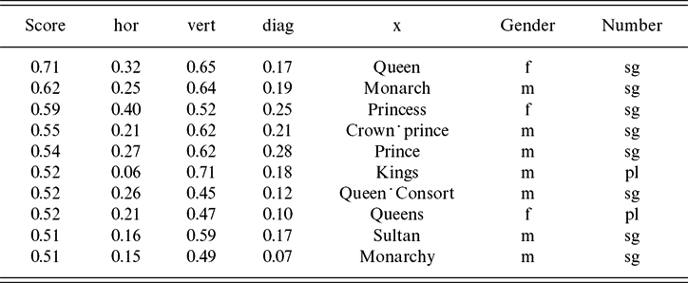
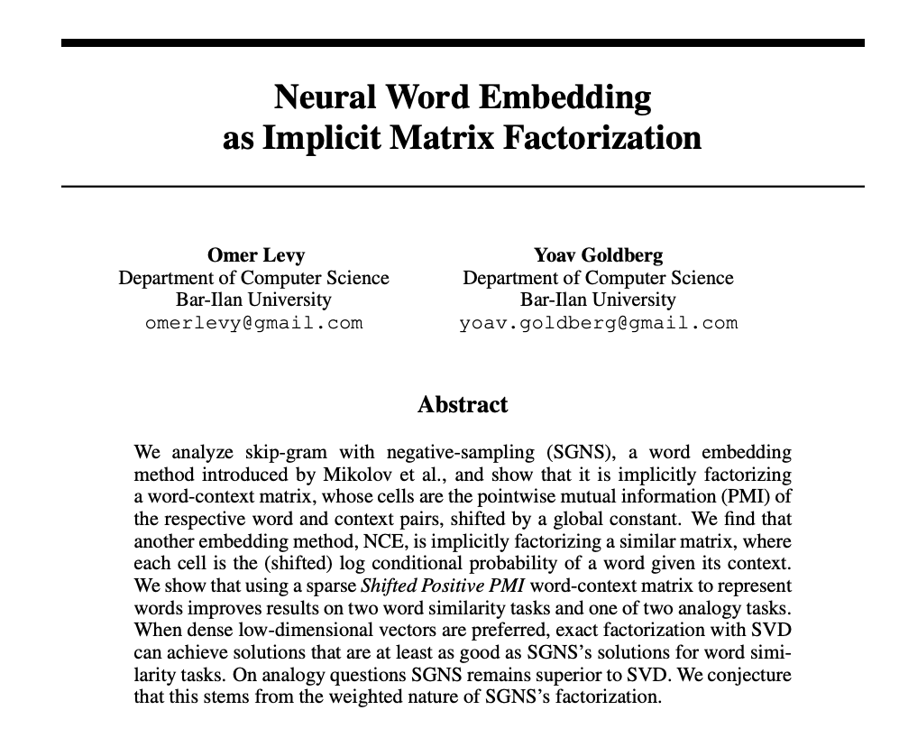
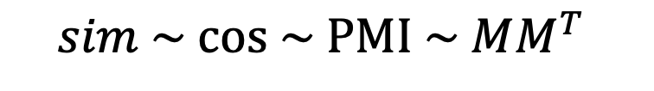
Word2Vec: Analogies
man is to woman
as king is to ???
Vector
Vector
Vector
cos
Paradigm Shift:
Features → Word Associations
$$sim \sim cos \sim PMI \sim MM^{T}⁡$$

Slide 19
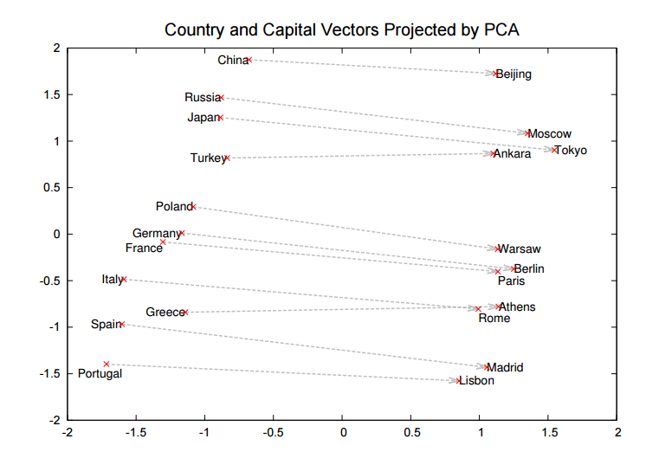
Word2Vec: More Promising Early Results
Countries
Capitals

Slide 20
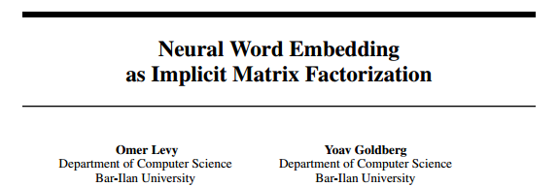
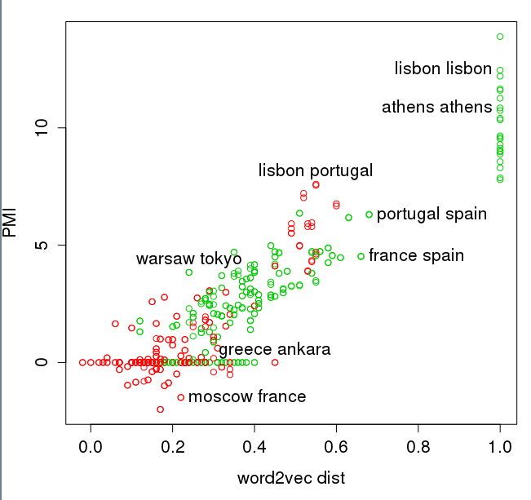
Levy & Goldberg (NIPS-2014) Word2Vec ≈ PMI (Pointwise Mutual Info)
Green → Type Match: Two Capitals or Two Countries
Red → Type Mismatch: A Capital and a Country

Slide 21
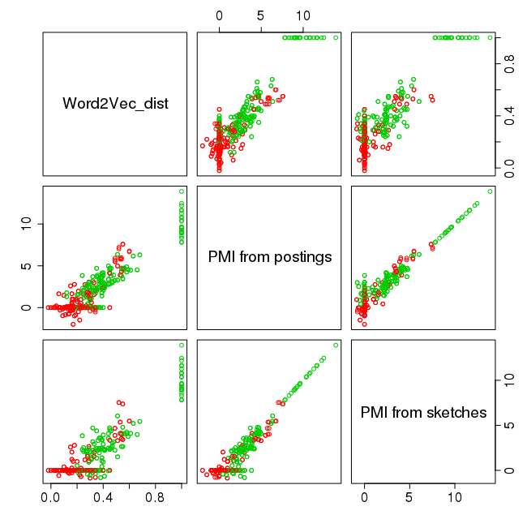
Levy & Goldberg (NIPS-2014) Word2Vec ≈ PMI (too simple to be right)
pairs in R
Green → Type Match: Two Capitals or Two Countries
Red → Type Mismatch: A Capital and a Country

Slide 22
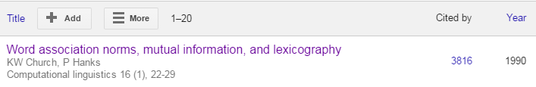
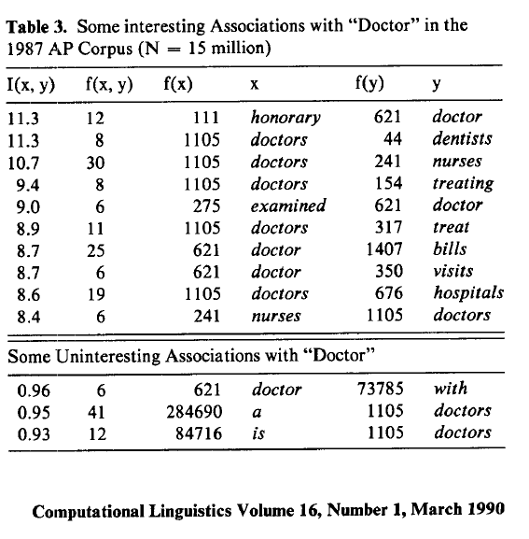
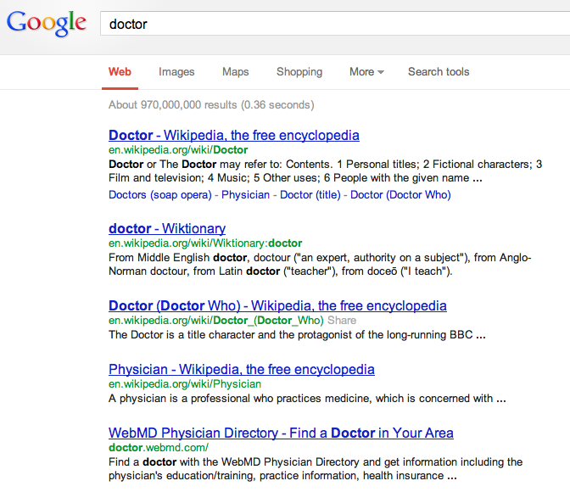
2016
Counts are growing 1000x per decade
(same as disks)
Counts are growing 1000x per decade
(same as disks)
Rising Tide of Data Lifts All Boats
Big Data →
Opportunities & Challenges

Slide 23
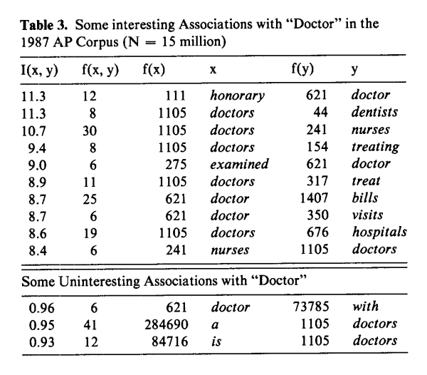
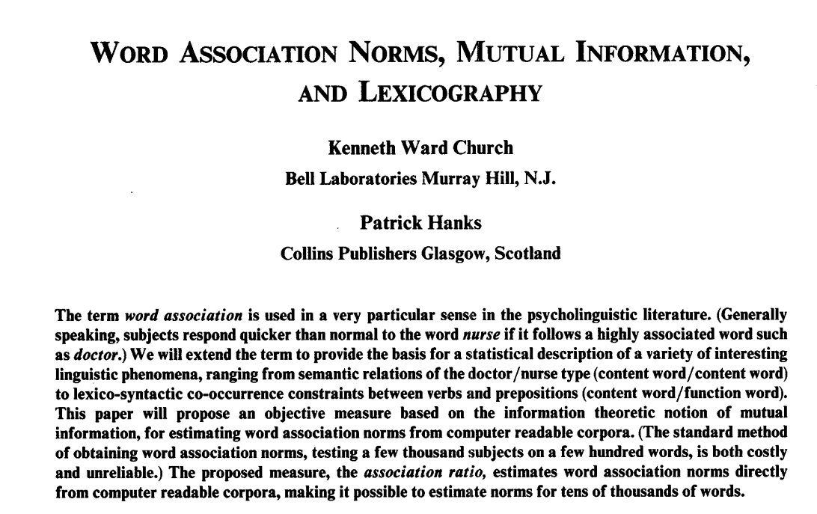
PMI: Interdisciplinary Combination of Empirical Methods from 1950s: Psycholinguistics, Information Theory, etc.
Word Associations: Doctor/Nurse
PMI (Pointwise Mutual Information)
``You shall know a word by the company it keeps’’ (Firth, 1957)

Slide 24
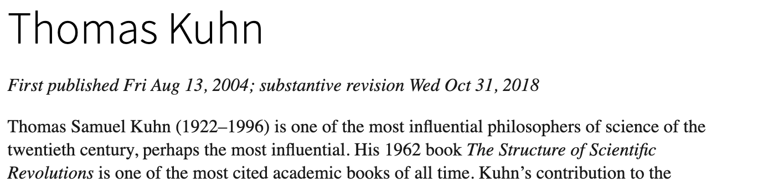

Paradigm Shifts
https://plato.stanford.edu/entries/thomas-kuhn/
Two conditions:
A few initial (promising, if not convincing) successes
that motivate early adopters (students) to do more, as well as
Leave room for early adopters to contribute and benefit by doing so.
Promising >> Convincing
ChatGPT is discouraging some students
Who think it is better than it is

Slide 25
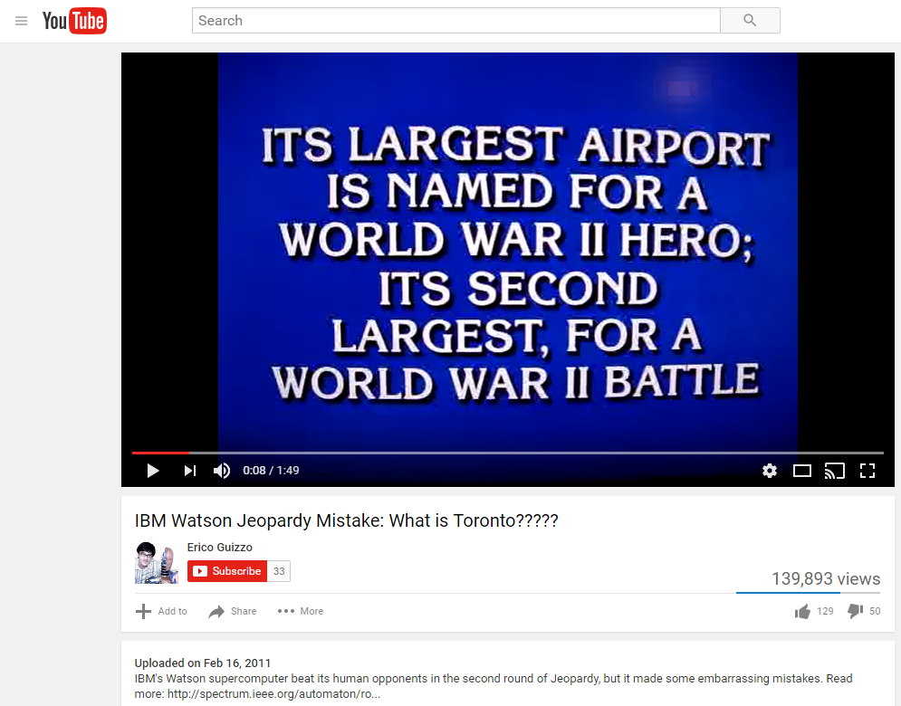
Promising >> Convincing To err is human, to really foul things up requires a computer
IBM Watson Jeopardy Mistake
Category: US Cities
Computer Error:
Toronto
Computer Error → ``Hallucination’’

Slide 26
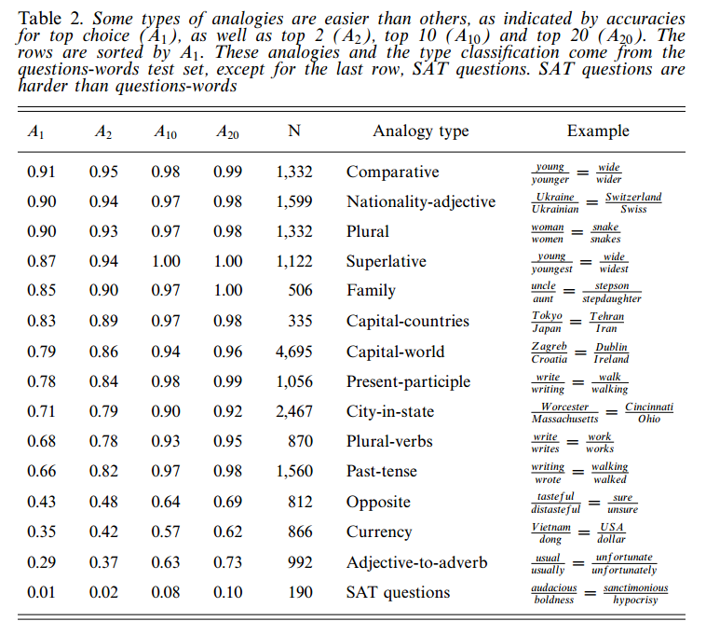
Evaluation: What you measure is what you get Word2vec: question-words >> SAT
⚠️ ⚠️ ⚠️ Warning ⚠️ ⚠️ ⚠️
Iffy Eval →
Unrealistic Expectations →
AI Winter
Question-words

Slide 27
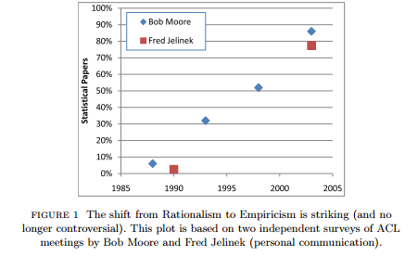
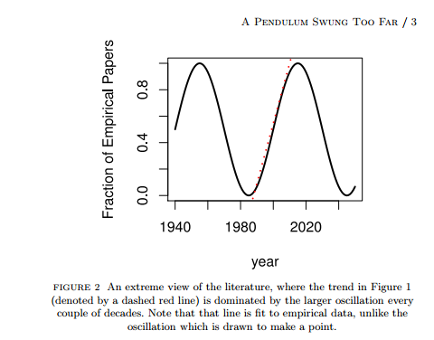
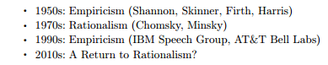
Grandparents and grandchildren have a natural alliance
⚠️ ⚠️ ⚠️ Warning ⚠️ ⚠️ ⚠️
Unrealistic Expectations → Winter
⚠️ ⚠️ ⚠️ Warning ⚠️ ⚠️ ⚠️
Unrealistic Expectations → Winter

Slide 28
Farce in Three Acts https://www.earningmyturns.org/2017/06/a-computational-linguistic-farce-in.html
Rationalism (1970s)
Empiricism (1990s)
Deep Nets (2010s)

Slide 29
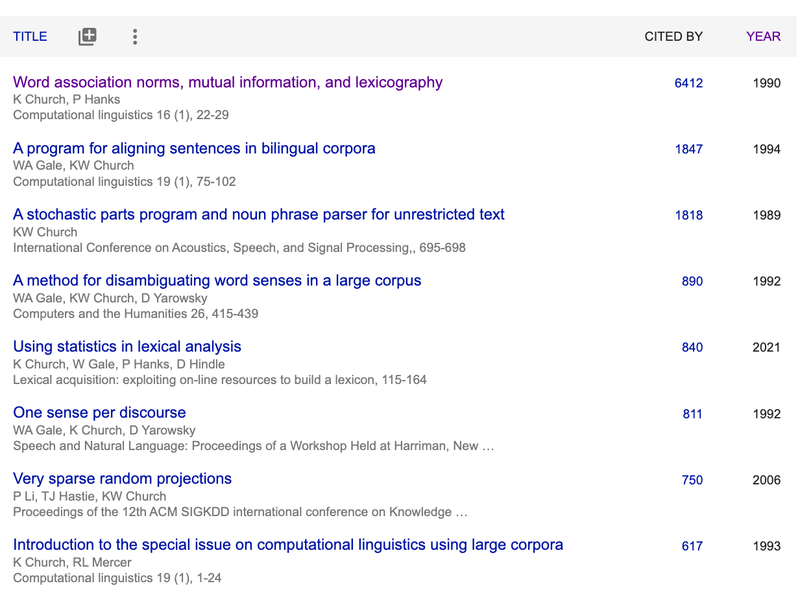
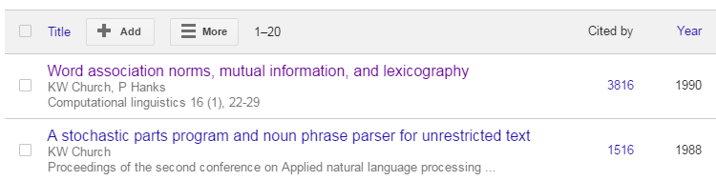
When I was a graduate student (just before AI Winter in 1980s)
2023
I was told that it was no longer possible to get a PhD in Syntax
Parsing had been declared “solved”
Even semantics was largely “solved”
I was told to go work on pragmatics
After graduating…
PMI
ANN
2016
Revival of 1950s Empiricism

Slide 30
Motivation for Revival of Empiricism in 1990s?
What were we rebelling against?
The revival was driven by pragmatic considerations.
The field had been banging its head on big hard challenges like
AI-complete problems and
long-distance dependencies.
We advocated a pragmatic pivot toward simple stuff
PMI (Pointwise Mutual Information)
Part of Speech Tagging
Aligning Parallel Corpora
Sketches & ANN (approx. nearest neigh)
Data was becoming available
like never before.
What can we do with all this data?
It is better to do something simple
(than nothing at all).
Let’s go pick some low hanging fruit.
Let’s do what we can with
short-distance dependencies.
That won’t solve the whole problem,
but let’s focus on what we can do
as opposed to what we can’t do.

Slide 31
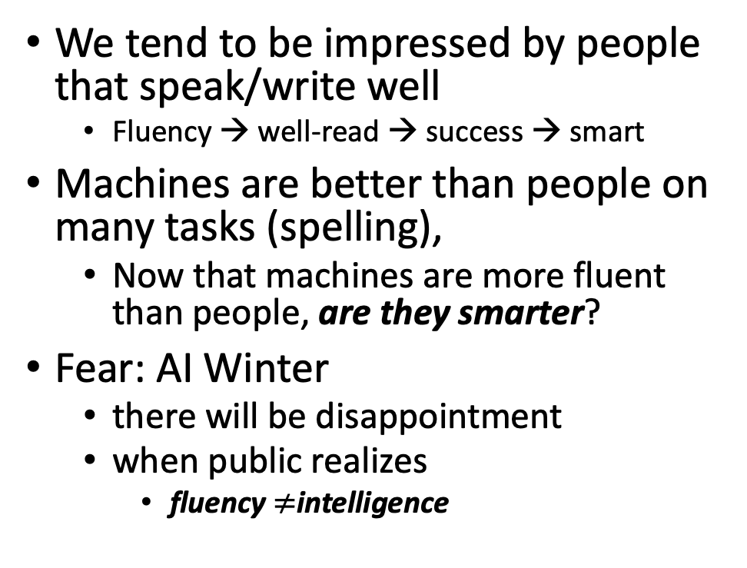
Part A: Glass is half full (deep nets can do much) Part B: Glass is half empty (always more to do)
Advocate combo of Part A with
AI Knowledge Representation
Linguistics and Philosophy
Pendulum Swung Too Far
There have been many AI Winters
Often, after ``irrational exuberance’’
(like current excitement with nets)
We tend to be impressed by people that speak/write well
Fluency → well-read → success → smart
Machines are better than people on many tasks (spelling),
Now that machines are more fluent than people, are they smarter?
Fear: AI Winter
there will be disappointment
when public realizes
fluency $≠$intelligence

Slide 32
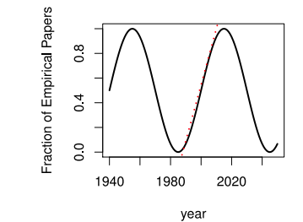
Large Language Models (LLMs) Strengths (1950s/1990s); Weaknesses (1970s)
Strengths (fluency)
1950s/1990s: Empiricism
Shannon, Skinner, Firth, Harris
You shall know a word by the company it keeps (Firth, 1957)
Collocations (Easy for Machines)
Distributional Hypothesis (Zellig Harris):
find patterns (more freq than chance)
no meaning (semantics), syntax, truth
PMI, Word2Vec, BERT
Weaknesses (Hallucinations)
1970s: Rationalism
Chomsky, Minsky
Truth (Hard for Machines)
logical form
temporal/spatial logic
possible worlds
Meaning
Purpose (Planning/Discourse)
Common Sense Knowledge

Slide 33
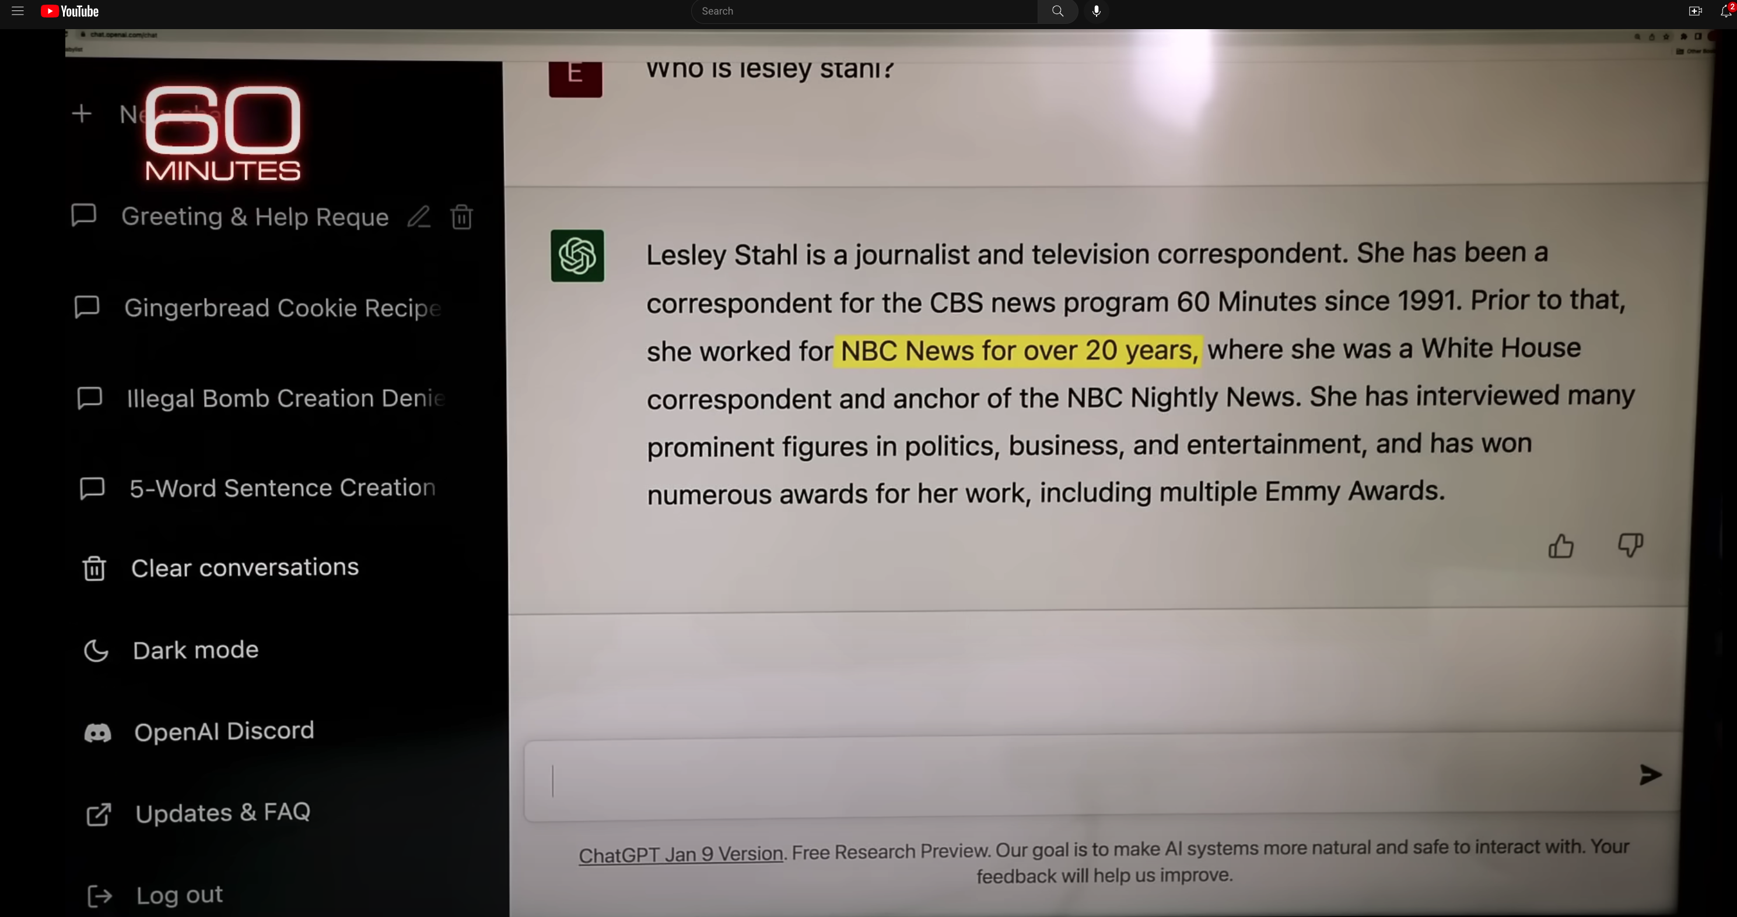
Hallucinations
Prompt
Language models
make up ``alternative facts’’
faster than fact-checking
Dangerous failure mode
People will believe these ``alternative facts’’
Hallucination
ChatGPT Hallucinates on CBS ``60 Minutes’’ https://www.youtube.com/watch?v=1wzPr4cUoMQ&t=463s
https://github.com/kwchurch/ACL2022_deepnets_tutorial
33

Slide 34
Hypo: Contribution = Primary + Secondary Literature
Contribution
Author Contributions: Primary Literature
Audience Appreciation: Secondary Sources (Surveys, Textbooks, Social Media, etc.)
Examples:
Cold War Opinion Piece: World Events → More Views
PMI: Subsequent work (Word2Vec/BERT) → More Citations
Rising tide lifts all boats

Slide 35
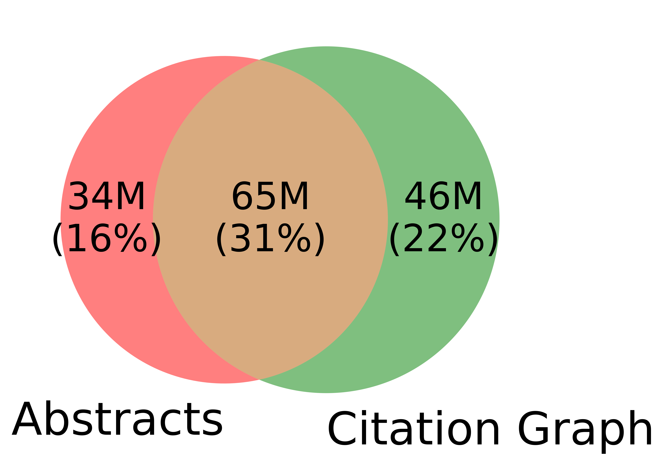
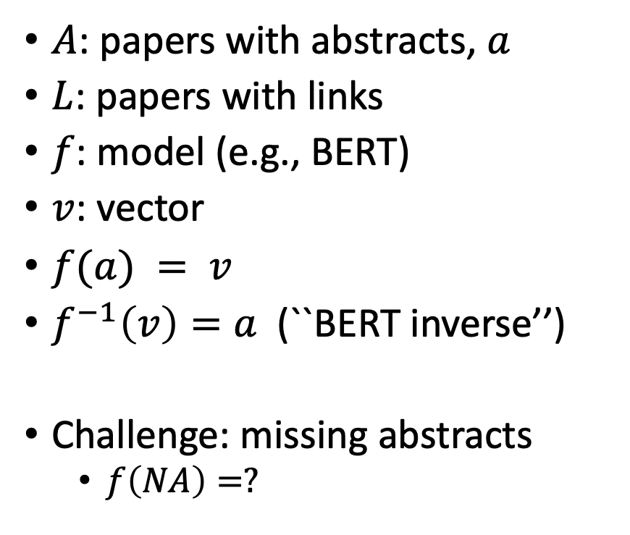
Realities: Missing Values
$A$: papers with abstracts, $a$
$L$: papers with links
$f$: model (e.g., BERT)
$v$: vector
$f(a) = v$
$f^{−1}\left(v\right)=a$(``BERT inverse’’)
Challenge: missing abstracts
$f\left(NA\right)=?$

Slide 36
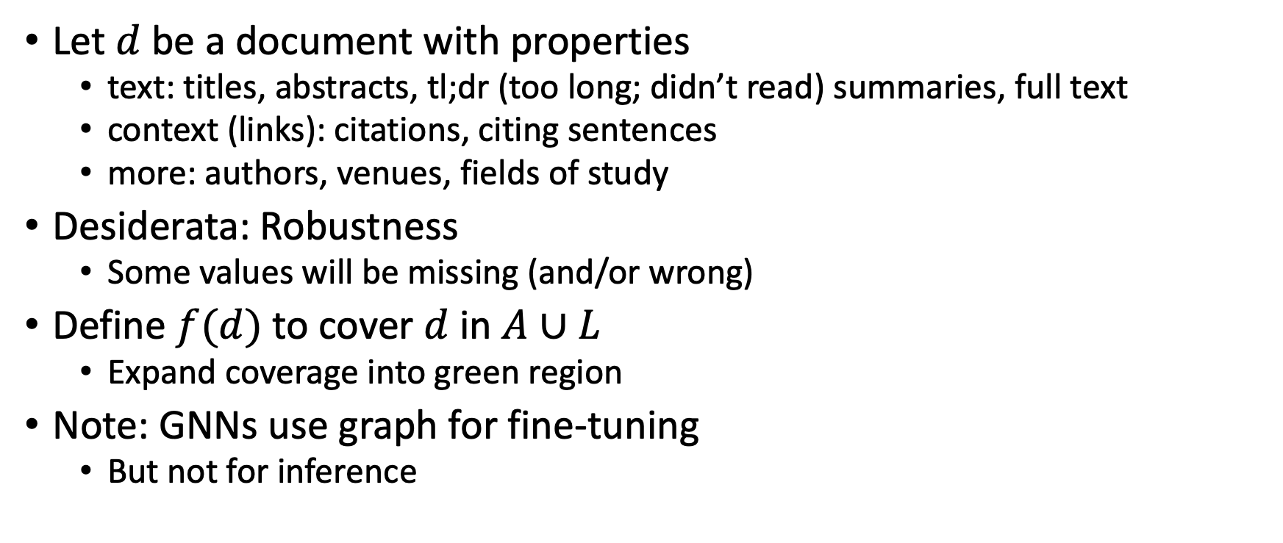
Suggestion for Missing Values
Let $d$ be a document with properties
text: titles, abstracts, tl;dr (too long; didn’t read) summaries, full text
context (links): citations, citing sentences
more: authors, venues, fields of study
Desiderata: Robustness
Some values will be missing (and/or wrong)
Define $f(d)$ to cover $d$ in $A∪L$
Expand coverage into green region
Note: GNNs use graph for fine-tuning
But not for inference

Slide 37
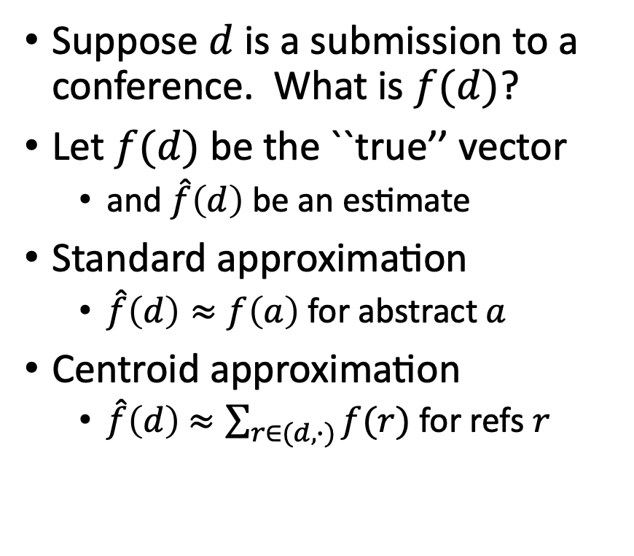
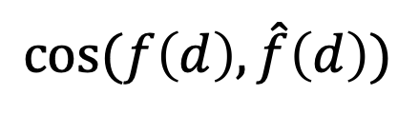
Centroid Assumption
Evidence for Centroid Approximation
Suppose $d$ is a submission to a conference. What is $f(d)$?
Let $f(d)$ be the ``true’’ vector
and $\hat{f}\left(d\right)$ be an estimate
Standard approximation
$\hat{f}\left(d\right)≈f\left(a\right)$ for abstract $a$
Centroid approximation
$\hat{f}\left(d\right)$ $≈\sum_{r∈(d,∙)}{f(r)}$ for refs $r$
$$cos⁡(f\left(d\right), \hat{f}\left(d\right))$$

Slide 38
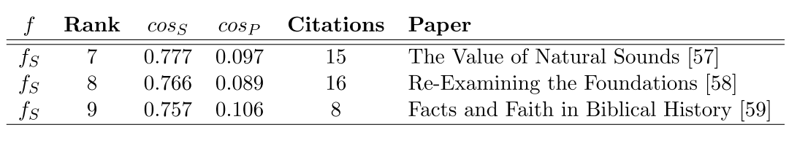
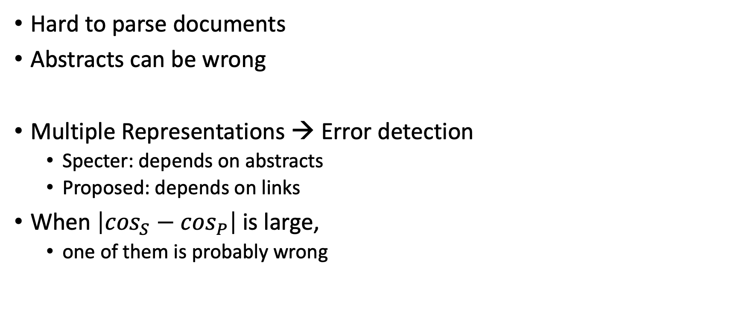
Bad/Misleading Values: Redundancy → Robustness
Hard to parse documents
Abstracts can be wrong
Multiple Representations → Error detection
Specter: depends on abstracts
Proposed: depends on links
When $\left|\cos_{S}−\cos_{P}\right|$is large,
one of them is probably wrong

Slide 39


Rank | Specter | Proposed | Paper
query | 1.000 | 1.000 | 1097: On stress and linguistic rhythm
1 | 0.908 | 0.926 | 0: Linguistic Society of America Structure and Intonation
2 | 0.895 | 0.977 | 475: Preliminaries to linguistic phonetics
3 | 0.885 | 0.921 | 25: Linguistic Society of America On the Definition of Word by
4 | 0.881 | 0.763 | 37: On some defferences between Chinese and Japanese '-Wh'-elements
5 | 0.880 | 0.946 | 2: Some accentuation properties in Japanese and lexical phonology
6 | 0.865 | 0.824 | 6: Two Types of Zi-Verbs in Japanese
7 | 0.777 | 0.097 | 15: The Value of Natural Sounds
8 | 0.766 | 0.089 | 16: Re-Examining the Foundations
9 | 0.757 | 0.106 | 8: Facts and Faith in Biblical History
1 | 0.578 | 0.998 | 226: The phonology of rhythm in English
2 | 0.530 | 0.997 | 74: A grid-based theory of English meter
3 | -1.000 | 0.996 | 5: "What does Phonology tell us about Stress and Rhythm? Some Reflections on the Phonology of Stress"
4 | 0.460 | 0.994 | 1: Syllable structure and stress in Bahdinani Kurdish
5 | 0.442 | 0.994 | 35: Schwa in phonological theory
6 | -1.000 | 0.994 | 163: The Sound Pattern of Russian: A Linguistic and Acoustical Investigation
7 | 0.542 | 0.993 | 27: Empirical evidence for a deletion formulation of the rhythm rule in English
8 | 0.552 | 0.993 | 95: Prosodic Structure Above the Word
9 | 0.334 | 0.993 | 0: Syllable Contraction in Cantonese A-not-A Constructions: An Optimality Account

Slide 40
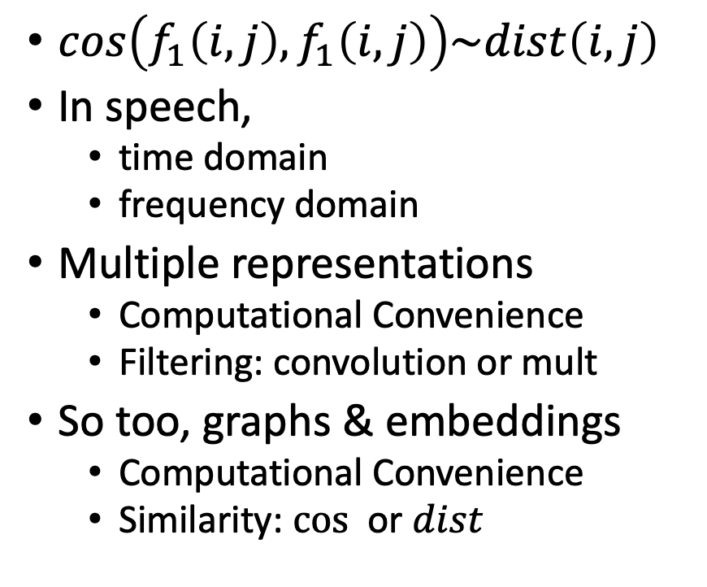
Cos-Dist: Multiple Views of Similarity
$cos\left(f_{1}\left(i, j\right),f_{1}\left(i, j\right)\right)\sim dist\left(i,j\right)$
In speech,
time domain
frequency domain
Multiple representations
Computational Convenience
Filtering: convolution or mult
So too, graphs & embeddings
Computational Convenience
Similarity: $cos⁡$ or $dist$

Slide 41
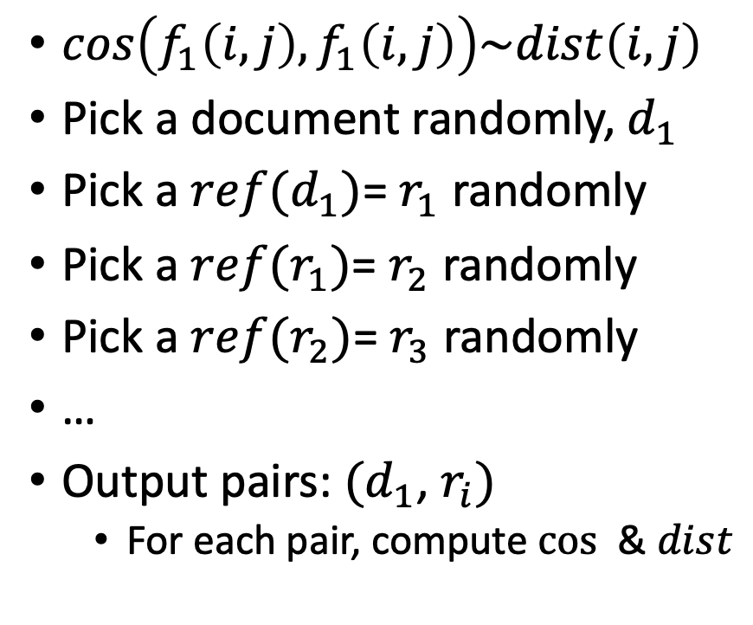
Random Walks
$cos\left(f_{1}\left(i, j\right),f_{1}\left(i, j\right)\right)\sim dist\left(i,j\right)$
Pick a document randomly, $d_{1}$
Pick a $ref(d_{1})$= $r_{1}$ randomly
Pick a $ref(r_{1})$= $r_{2}$ randomly
Pick a $ref(r_{2})$= $r_{3}$ randomly
…
Output pairs: $(d_{1}$, $r_{i})$
For each pair, compute $cos⁡$ & $dist$

Slide 42
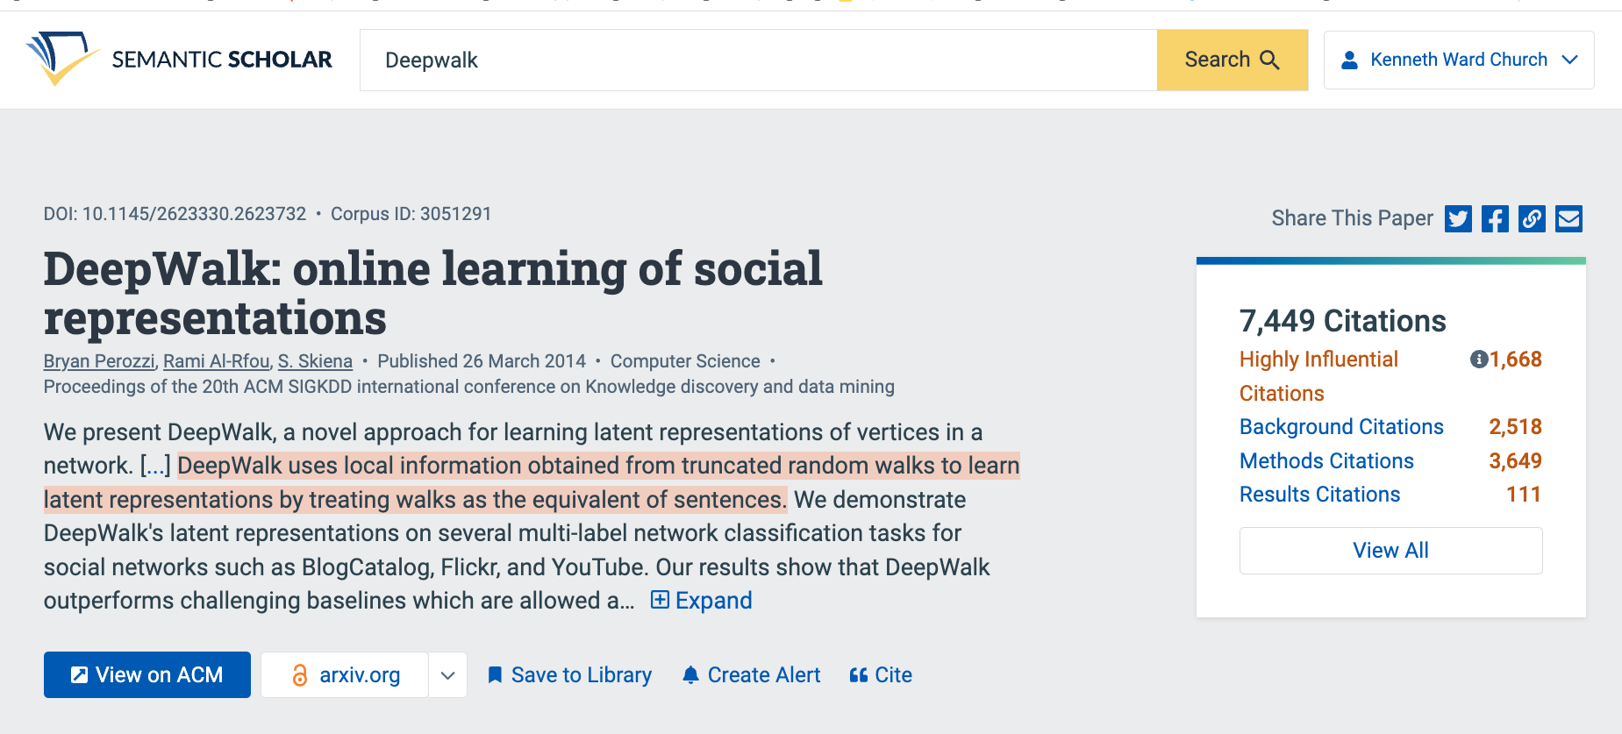
Summaries
Snippets
titles, authors, abstracts
tl;dr (too long; didn’t read)
Author Perspective:
These snippets
Audience Perspective:
Do these snippets capture 7k citations?
Why is this paper important
to contemporary readers?
Spectral Clustering

Slide 43
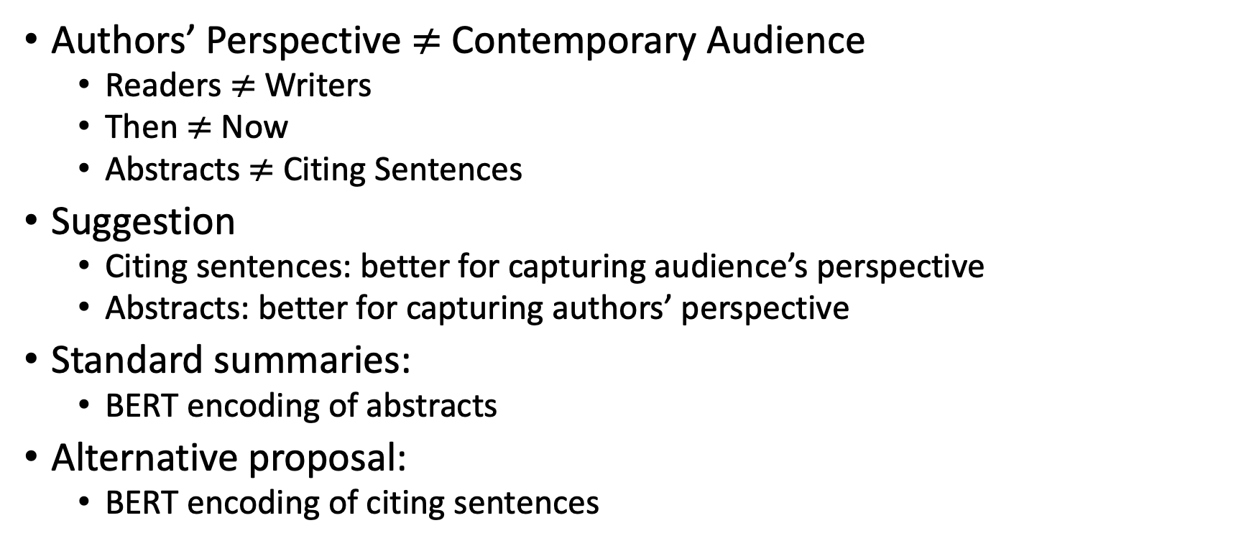

Why is paper $x$ important to contemporary readers?
Authors’ Perspective $≠$Contemporary Audience
Readers $≠$ Writers
Then $≠$ Now
Abstracts $≠$ Citing Sentences
Suggestion
Citing sentences: better for capturing audience’s perspective
Abstracts: better for capturing authors’ perspective
Standard summaries:
BERT encoding of abstracts
Alternative proposal:
BERT encoding of citing sentences

Slide 44
Summarization Baselines
tl;dr
ChatGPT
⚠️ ⚠️ ⚠️ Warning ⚠️ ⚠️ ⚠️
Hallucinations

Slide 45
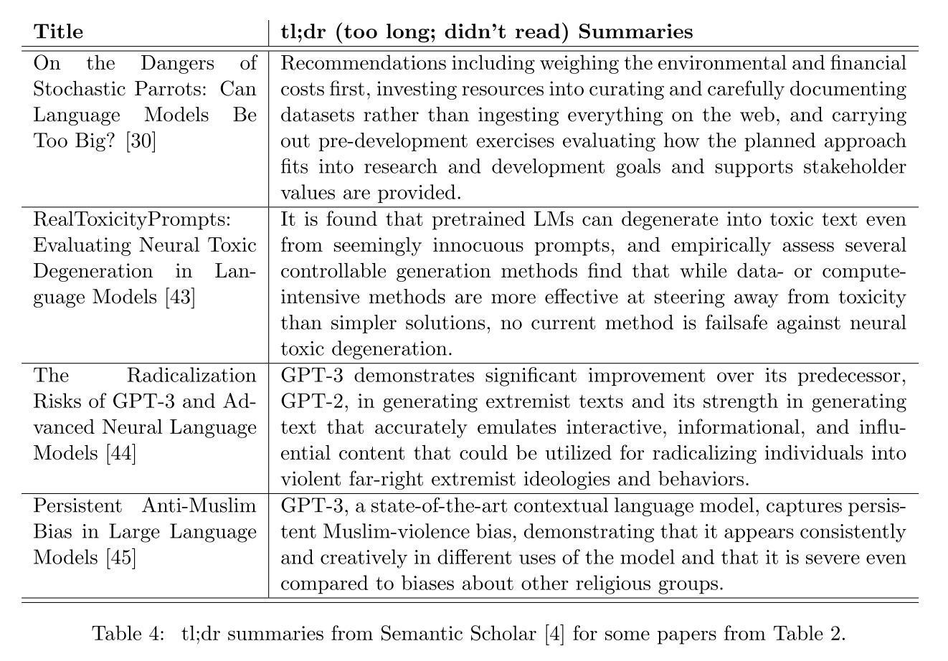

Slide 46
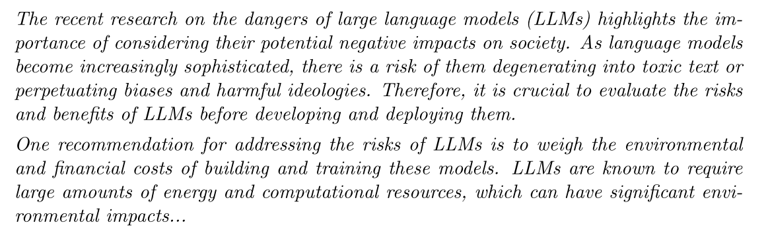
tl;dr → ChatGPT
Desiderata:
One-at-a-time → Pairwise Sim/diff

Slide 47
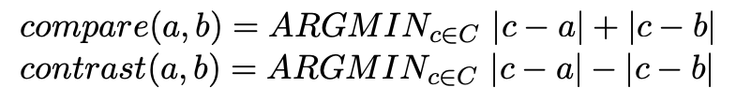
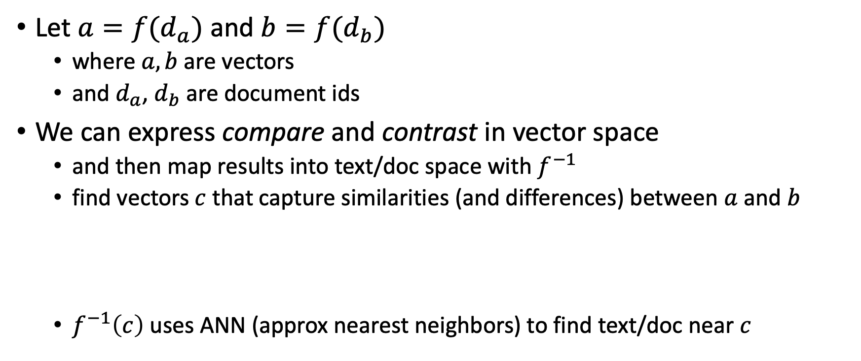
Summarization: Compare & Contrast
Let $a=f(d_{a})$ and $b=f(d_{b})$
where $a, b$are vectors
and $d_{a}$, $d_{b}$are document ids
We can express compare and contrast in vector space
and then map results into text/doc space with $f^{−1}$
find vectors $c$ that capture similarities (and differences) between $a$ and $b$
$f^{−1}\left(c\right)$ uses ANN (approx nearest neighbors) to find text/doc near $c$

Slide 48
https://github.com/kwchurch/JSALT_Better_Together
Team Page
Zoom Link
Github with source code
large datasets from Globus
Slides
Meeting Notes
Notation
Deliverables
Reading List
SciRepEval Baselines
Similar Venues
Code
Embeddings
Examples
Exercises (Lab for for this afternoon)
https://github.com/kwchurch/JSALT_Better_Together/tree/main/doc/exercises

